Slide 1
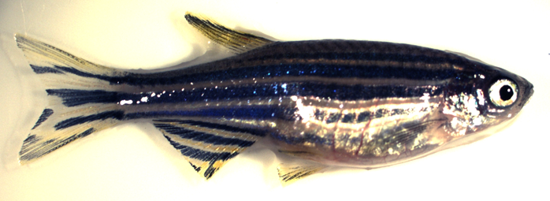

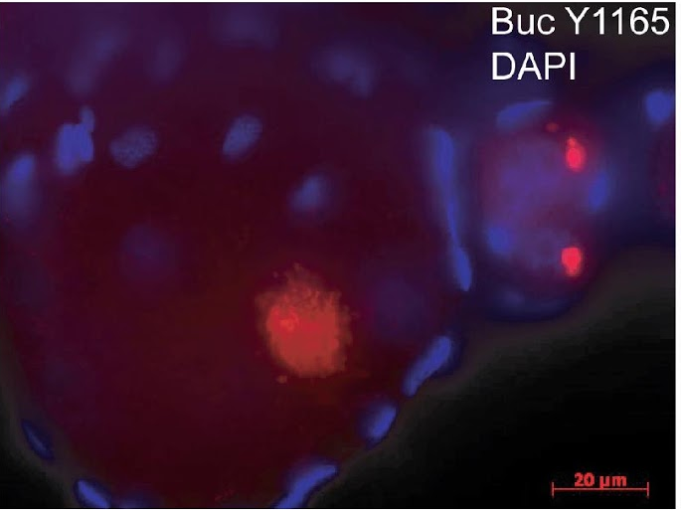
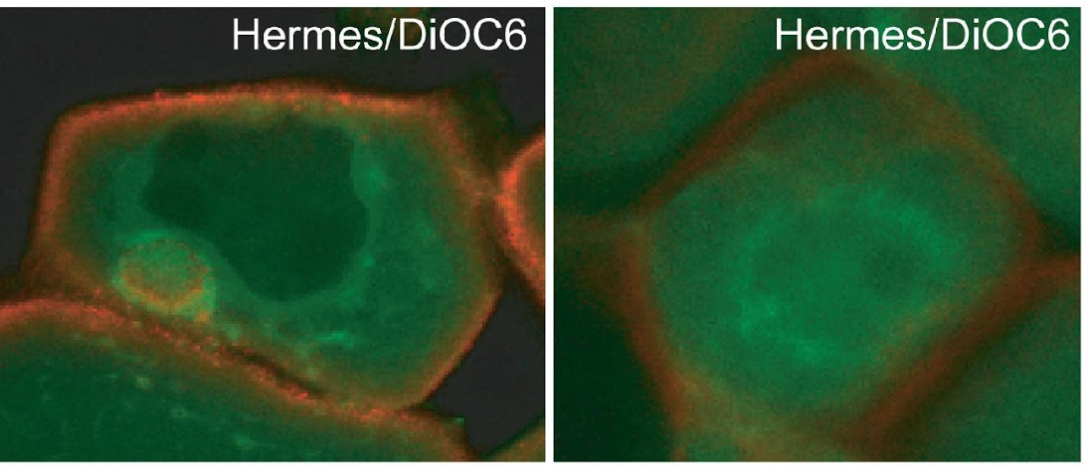
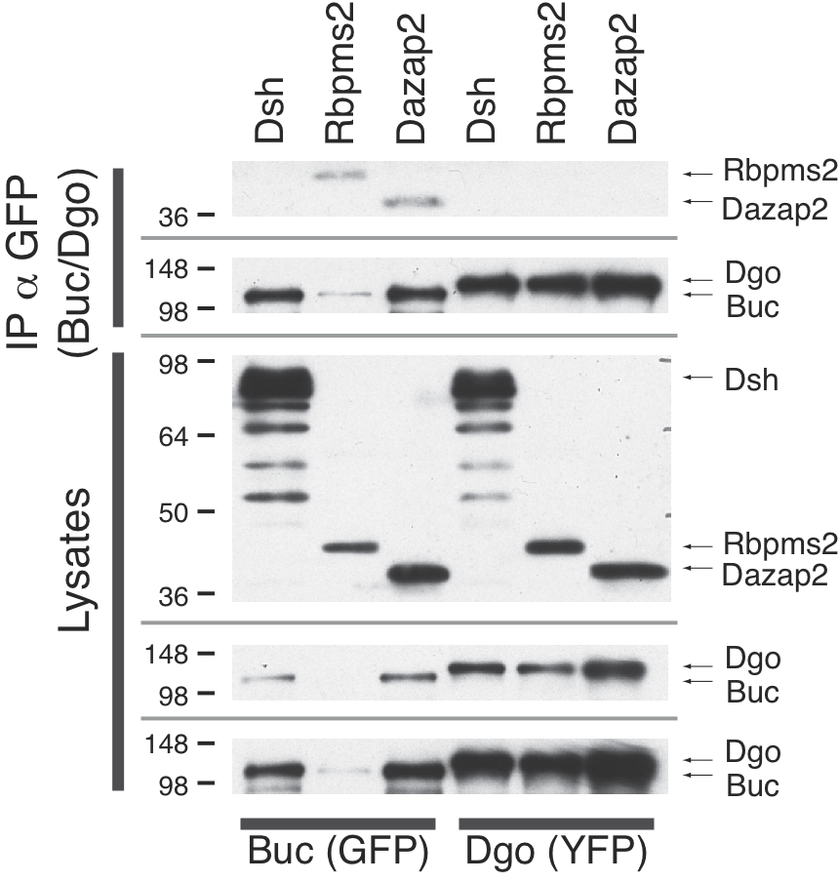
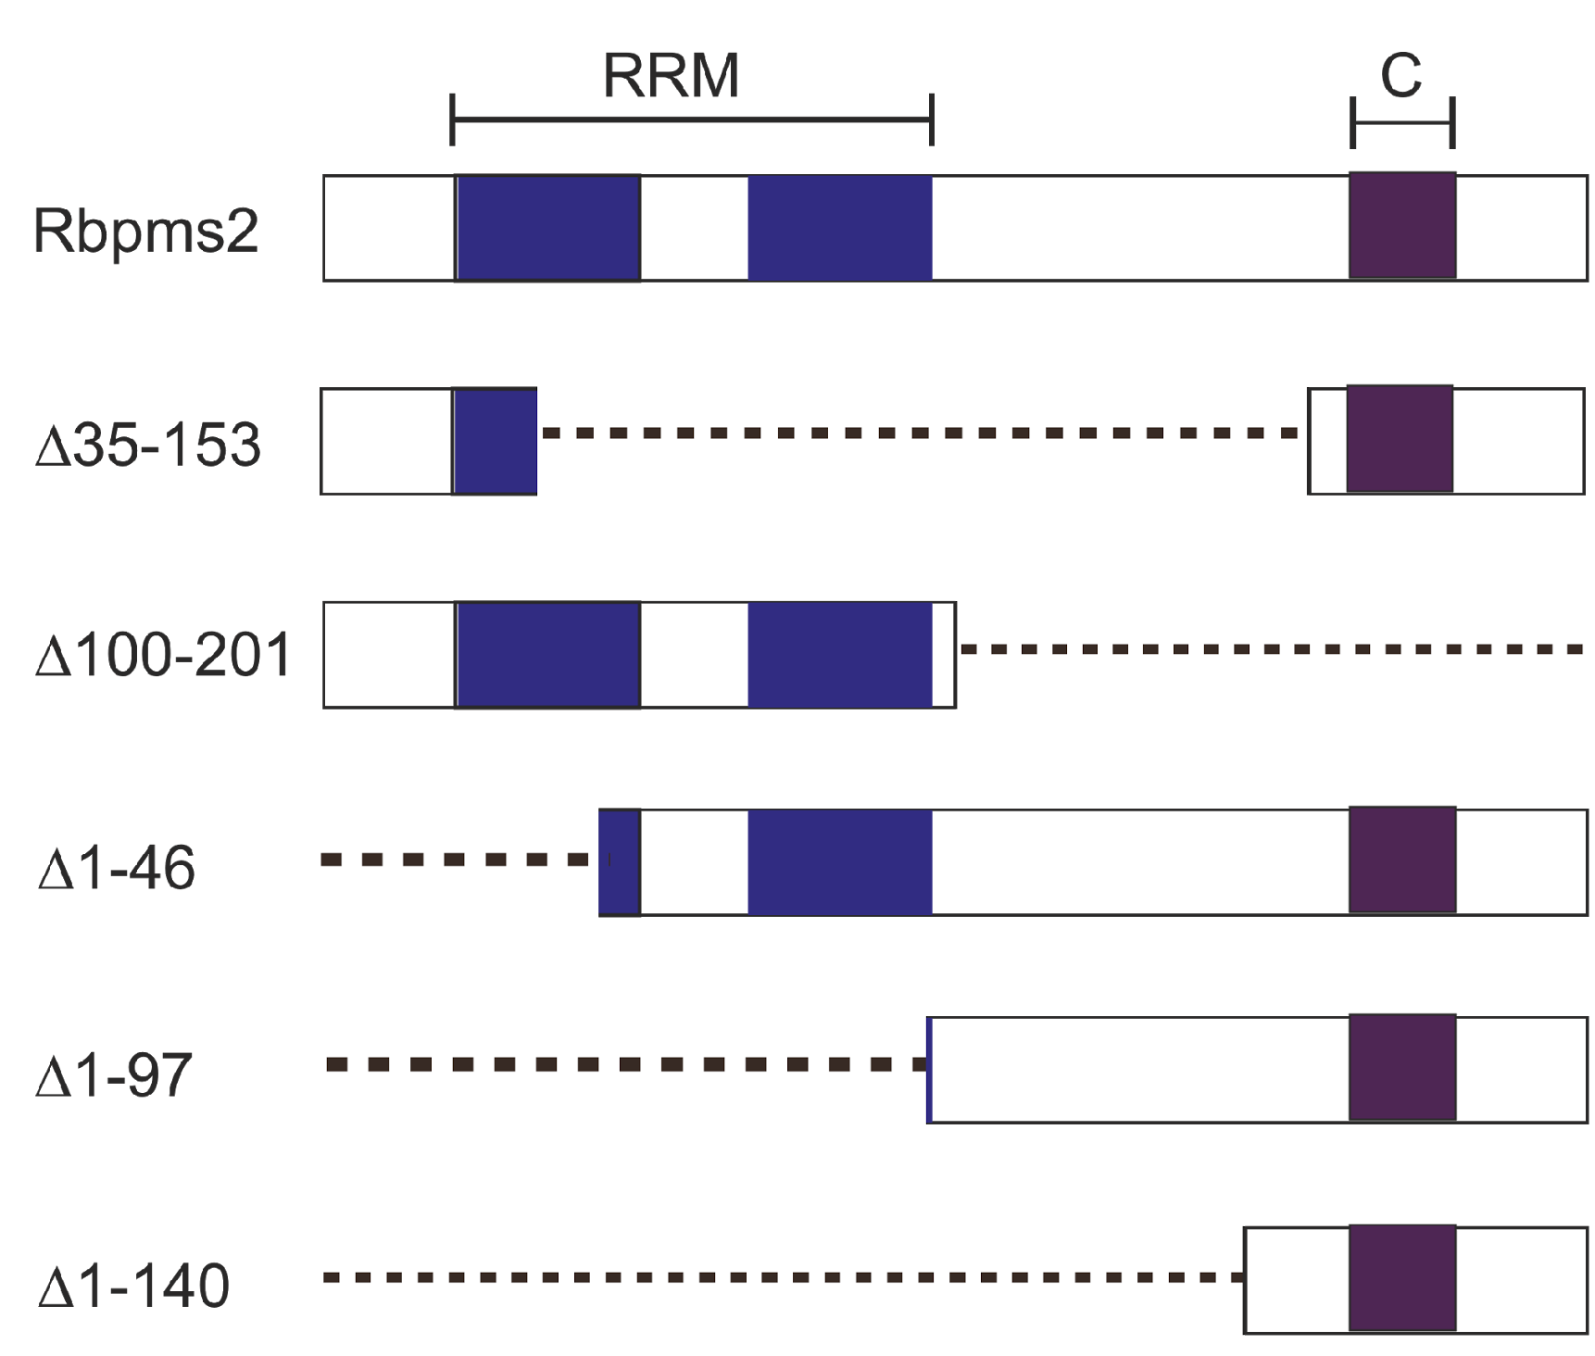
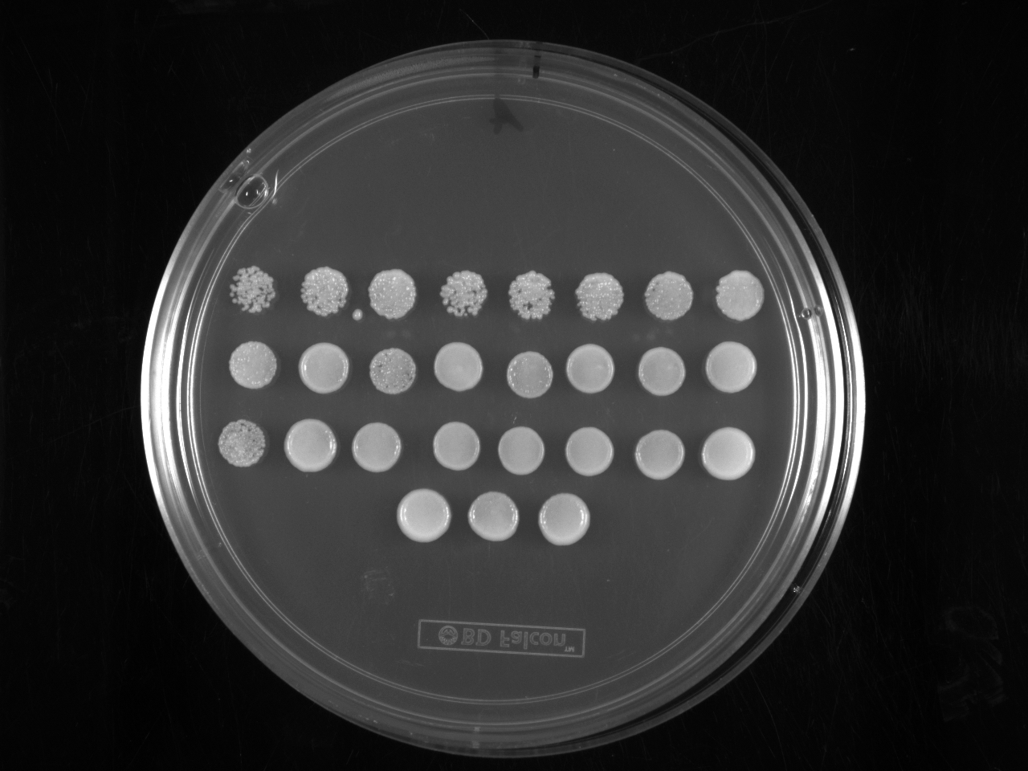
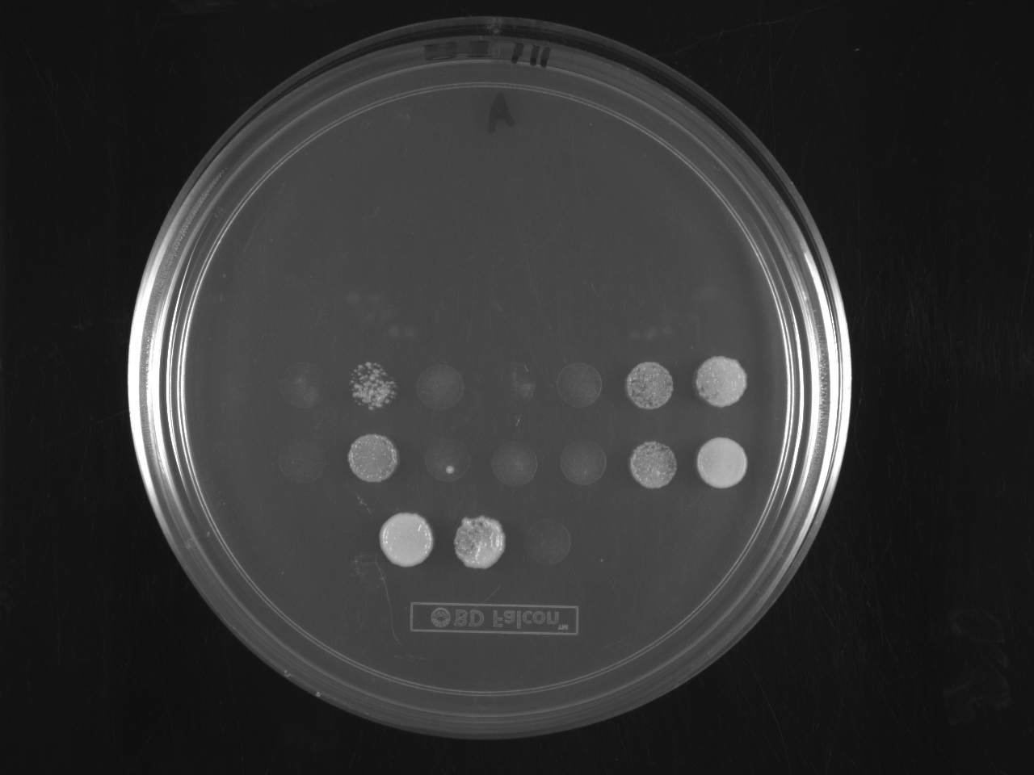



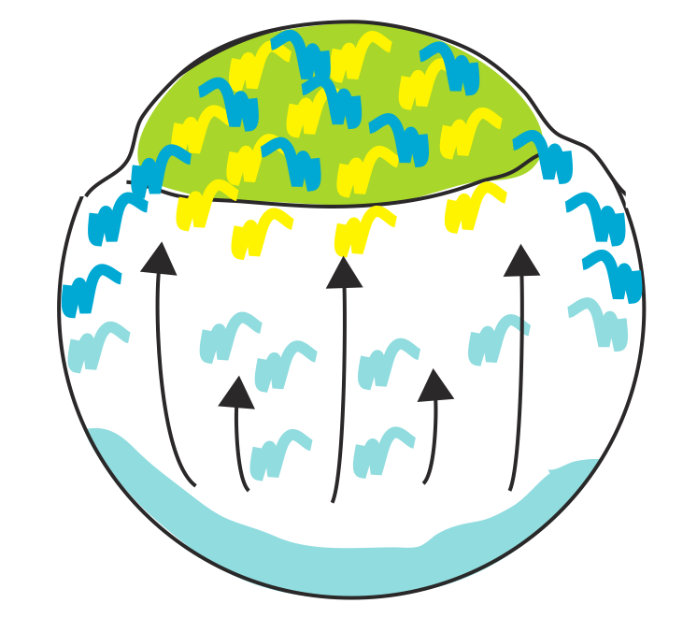
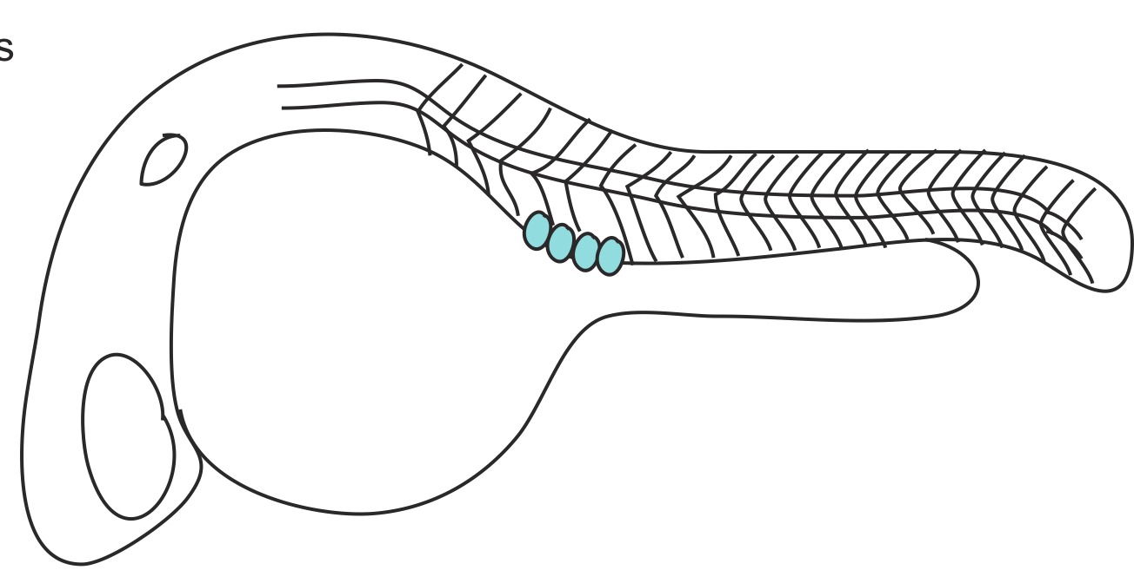

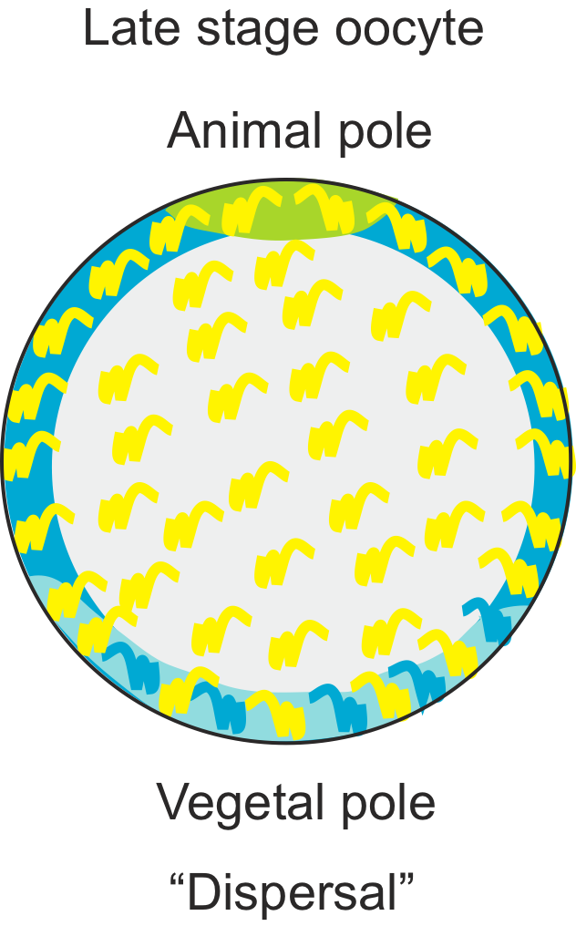
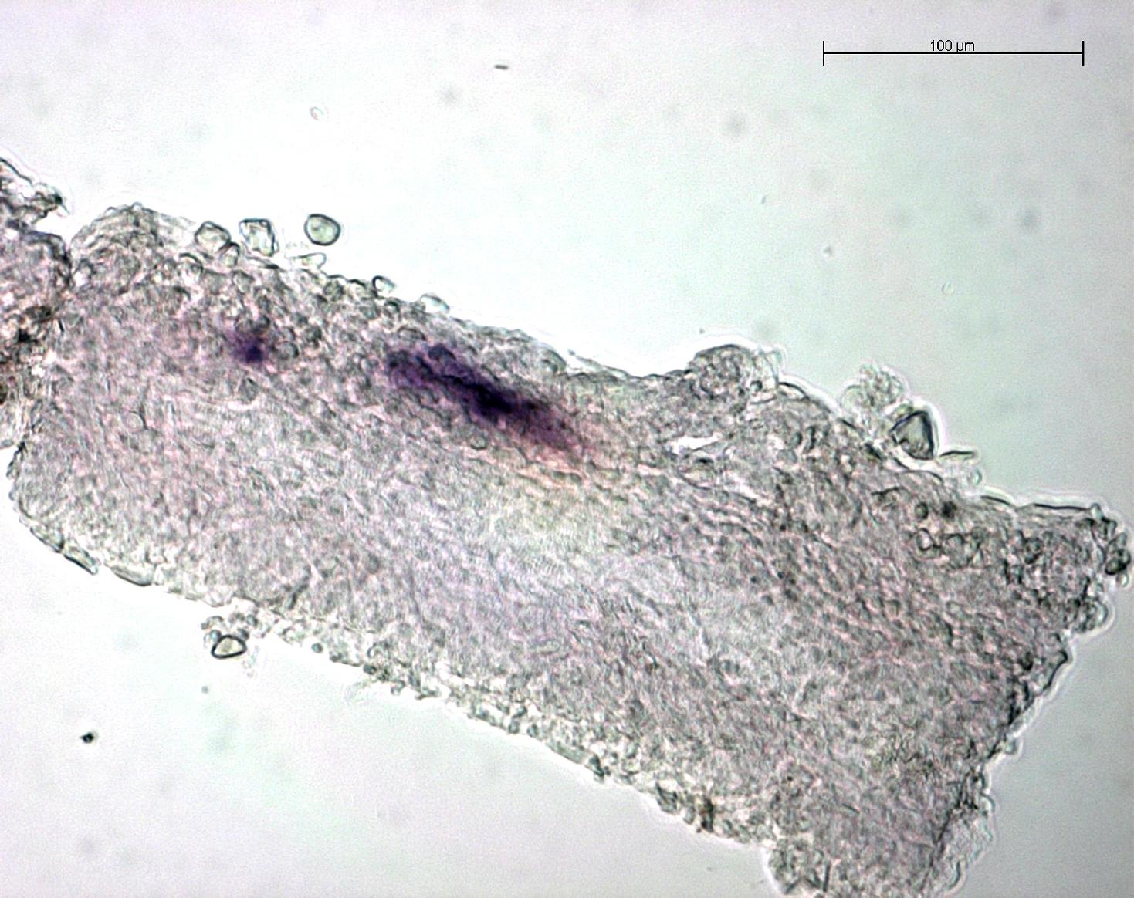
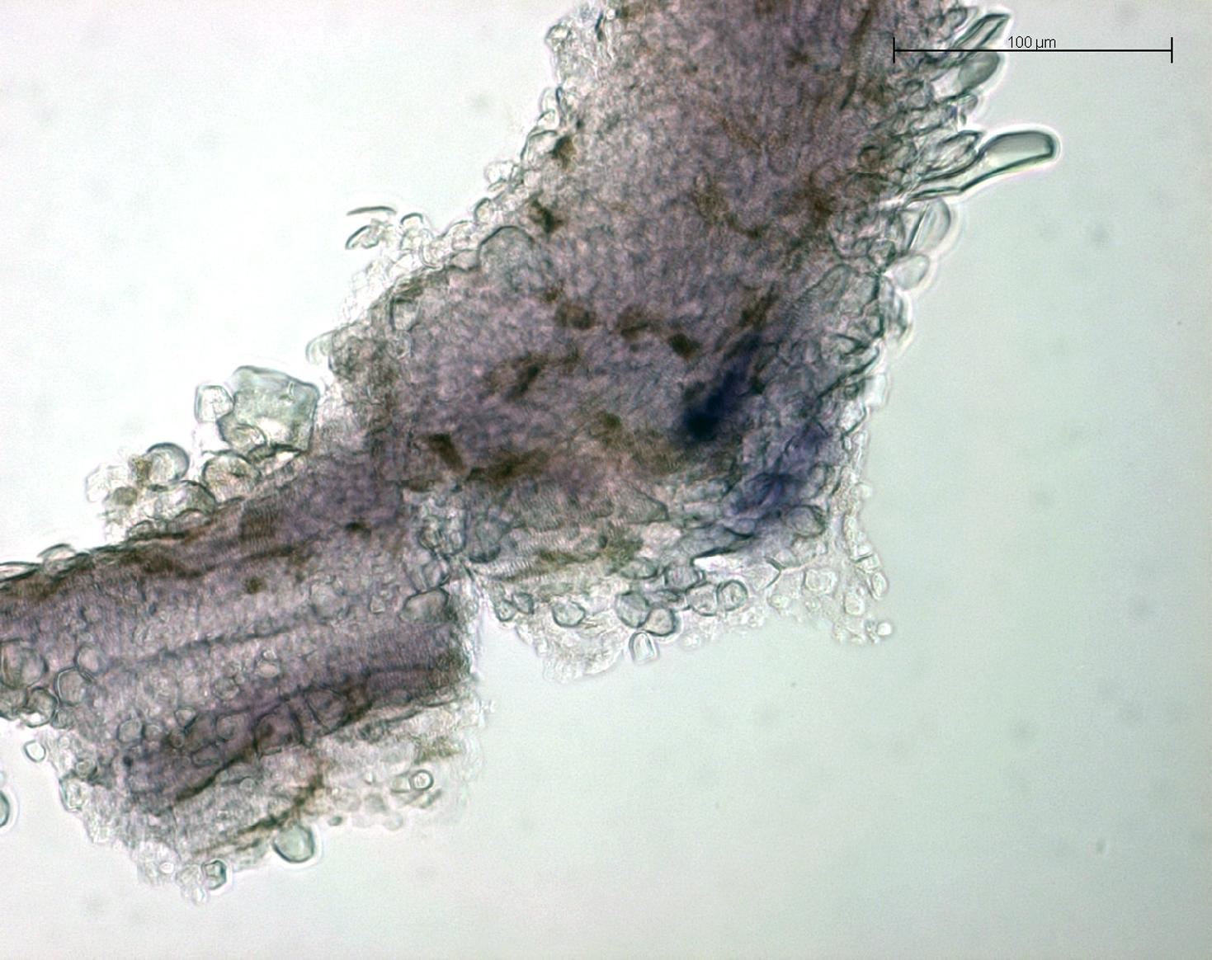


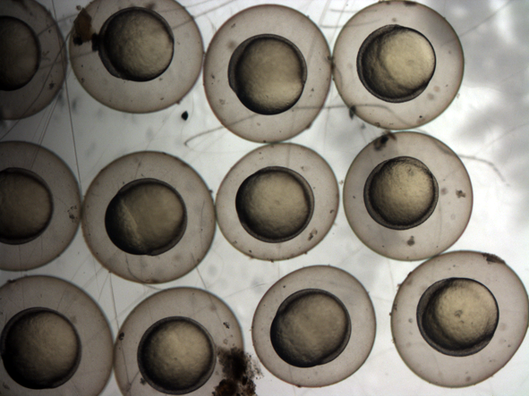
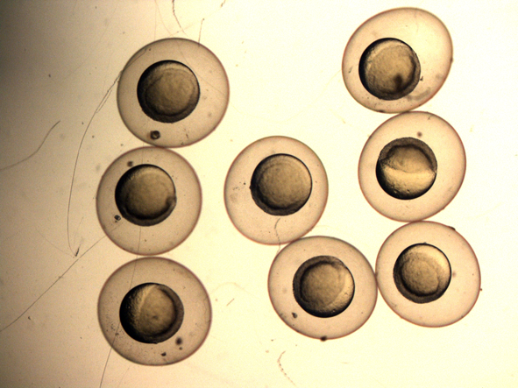
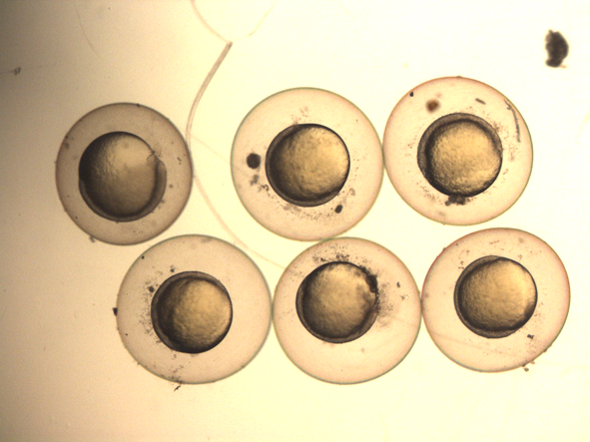
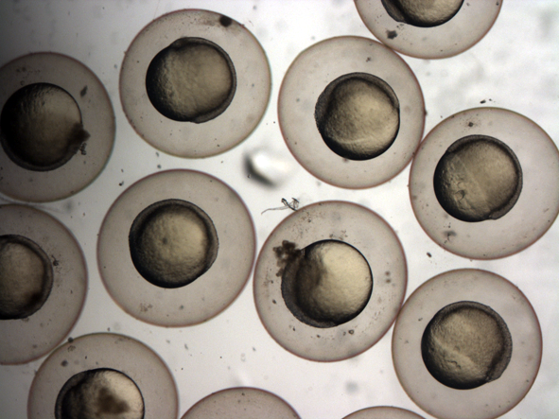
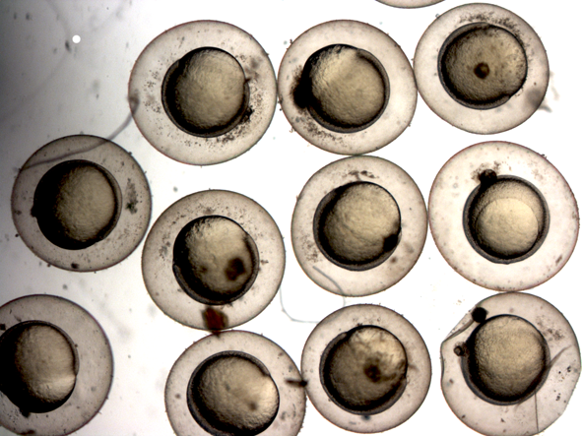
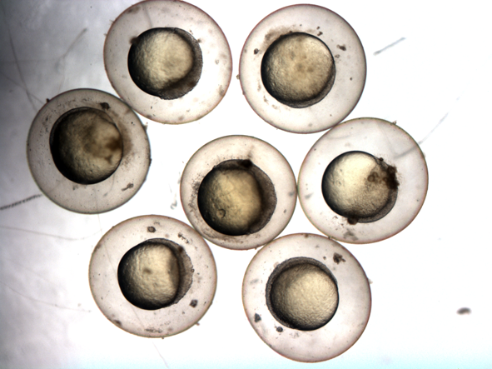
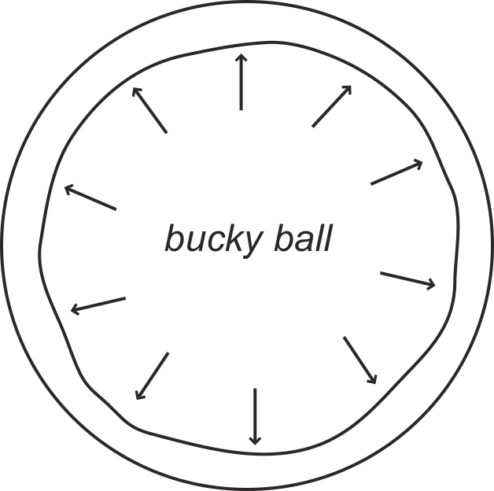
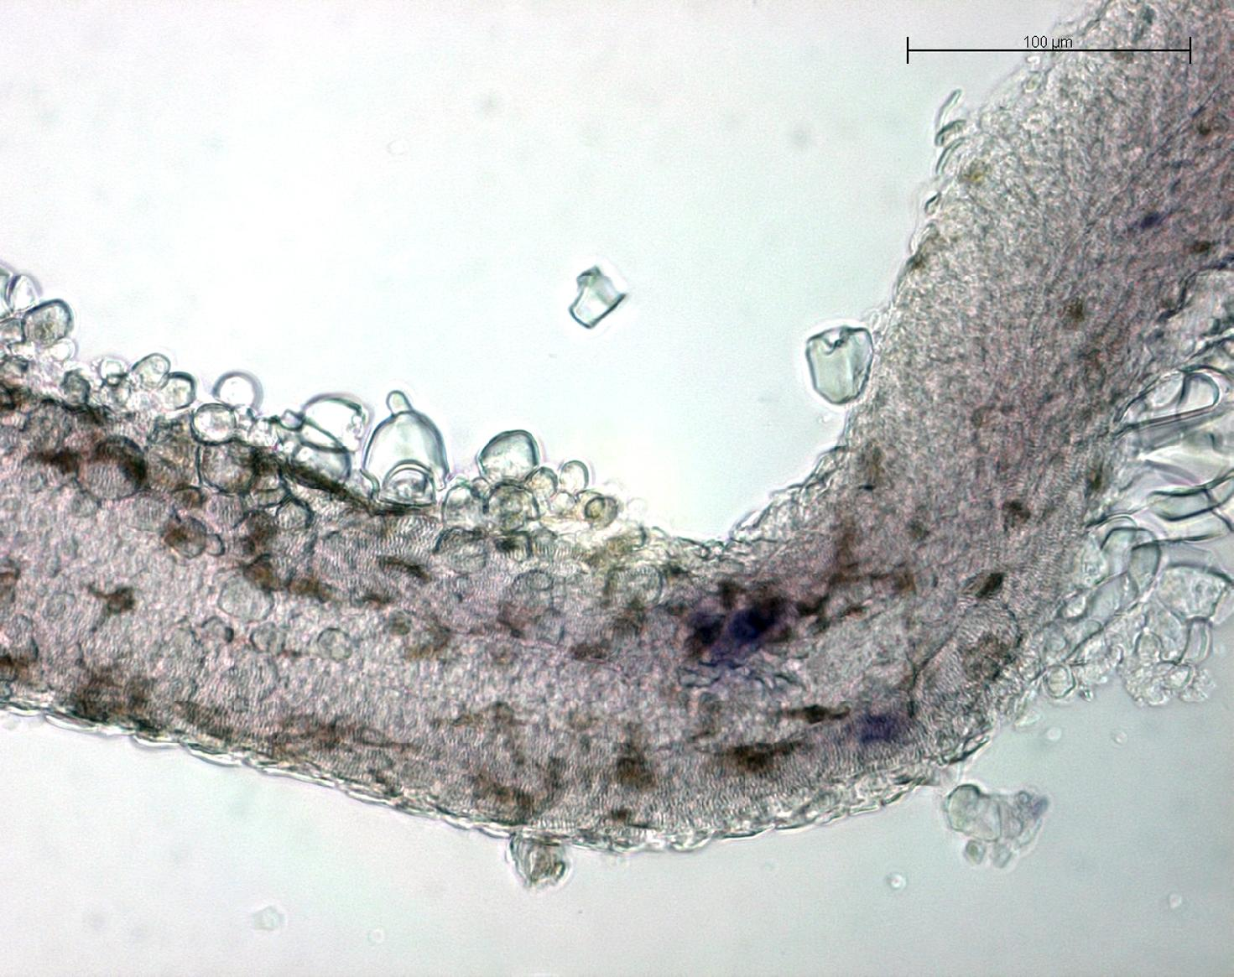
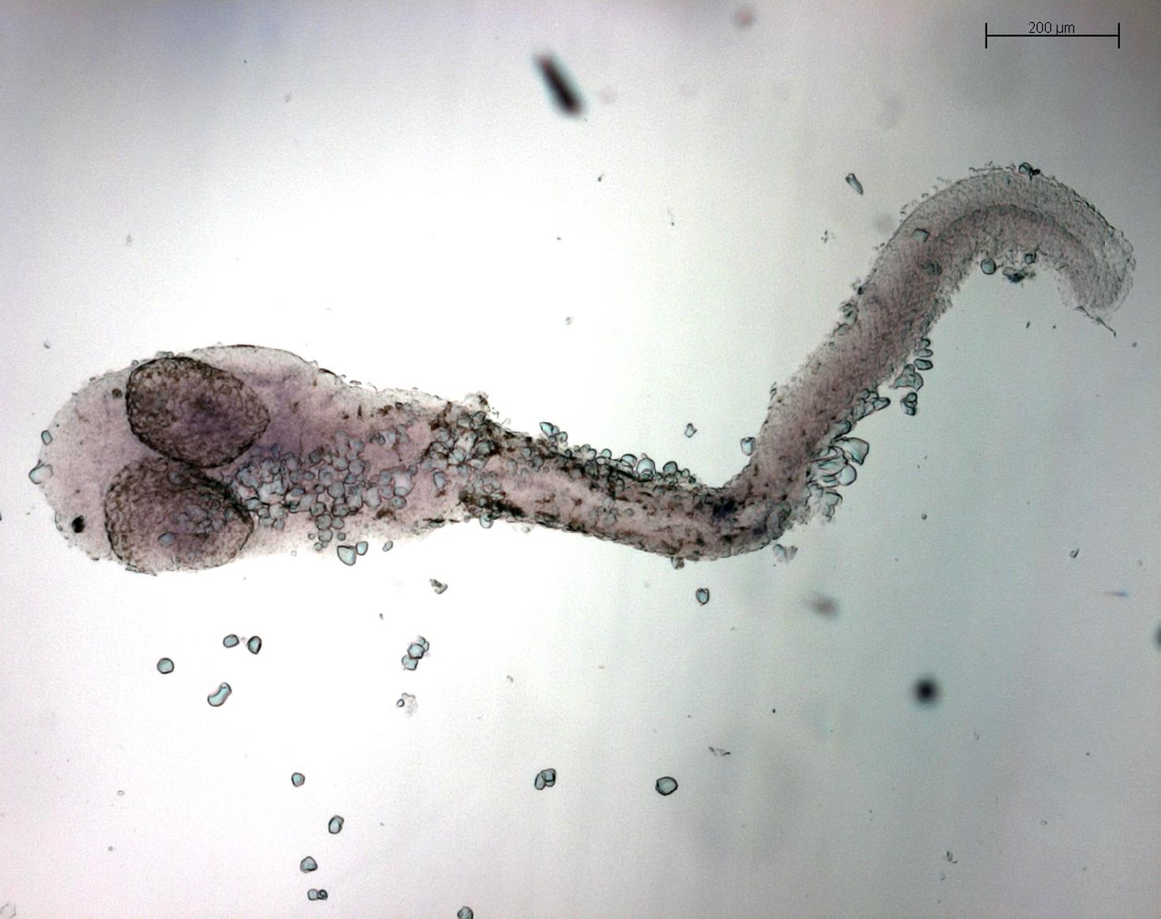
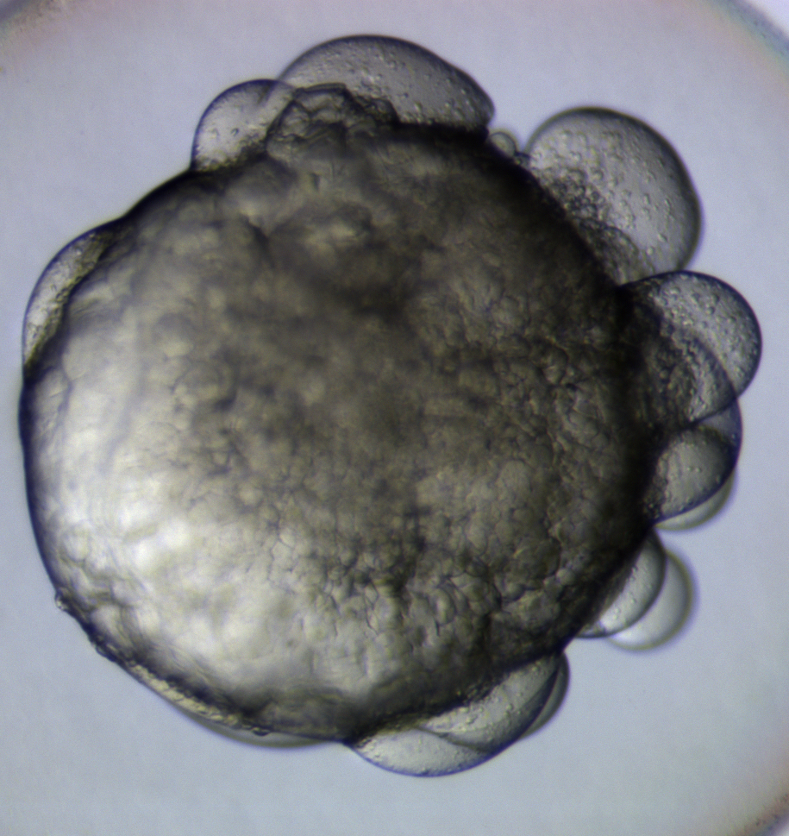
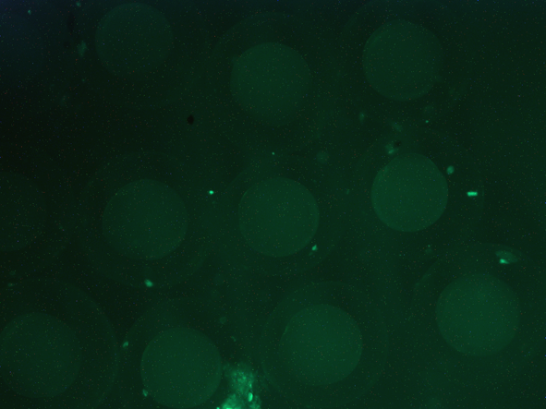
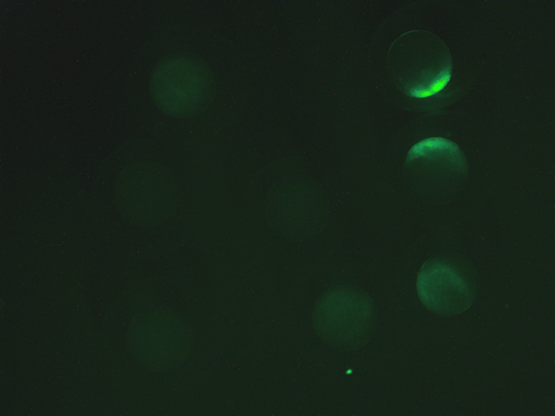
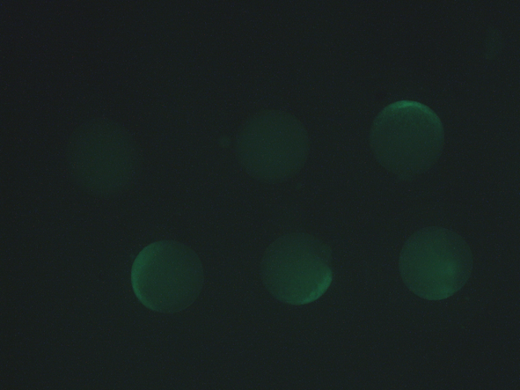
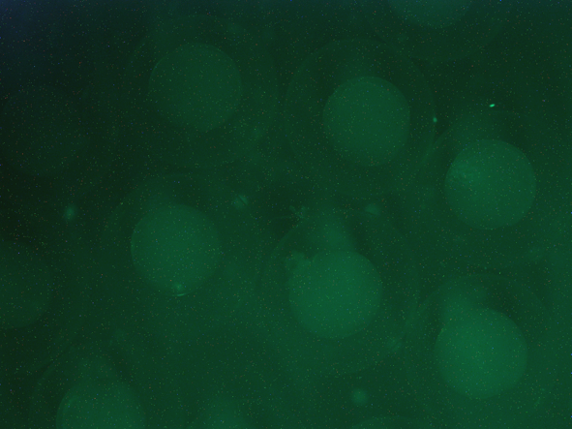
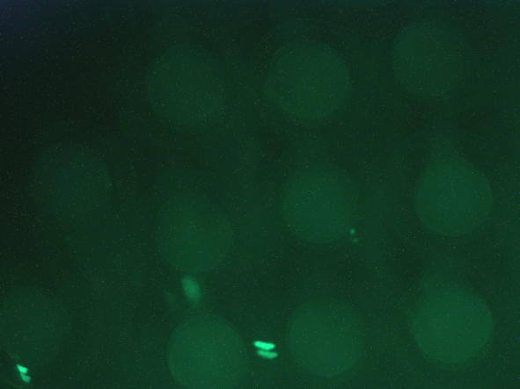
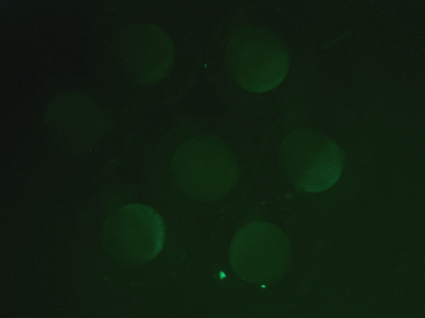
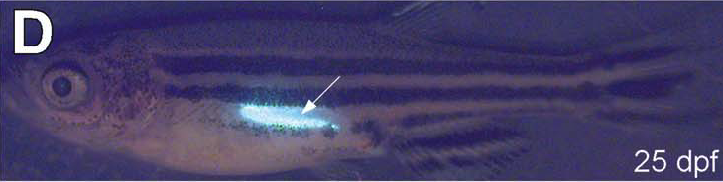
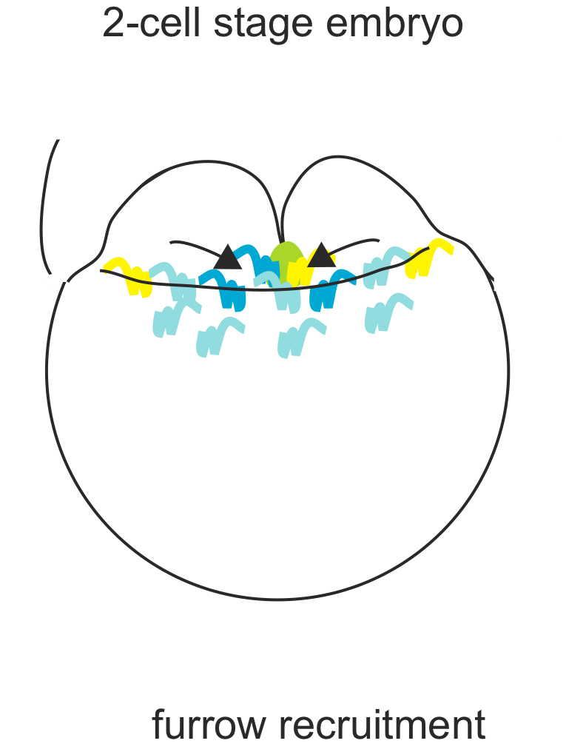
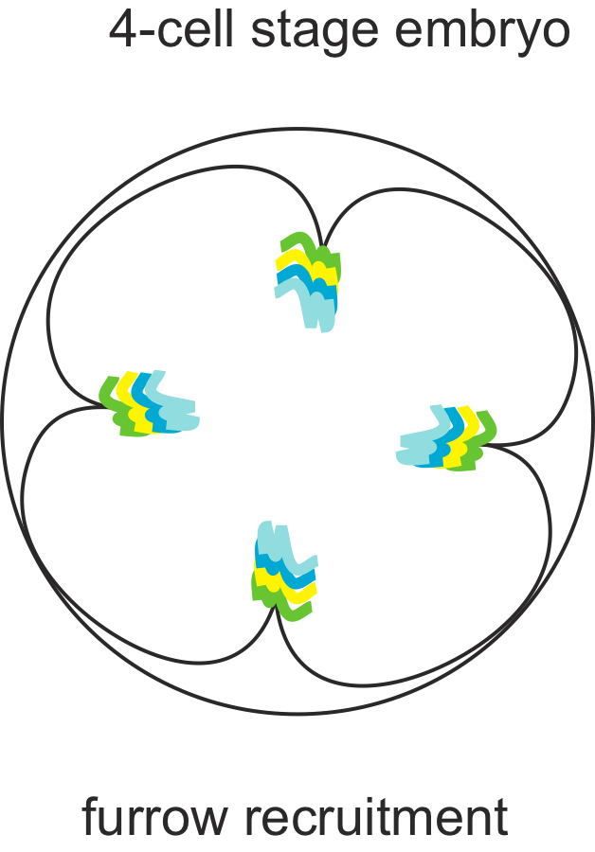
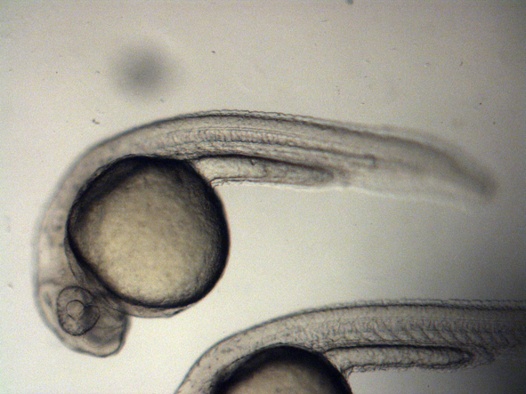
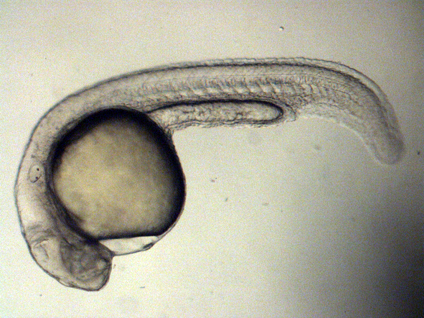
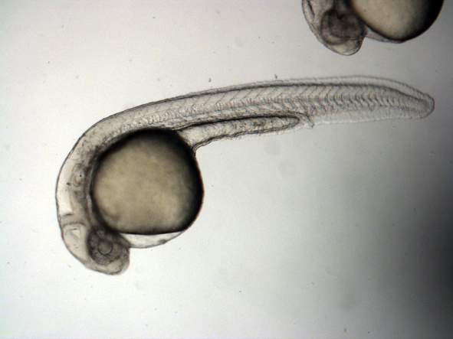
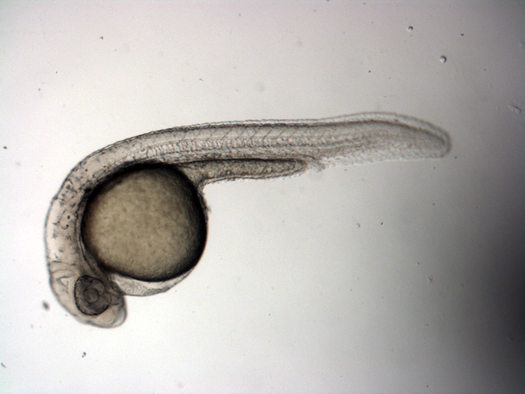
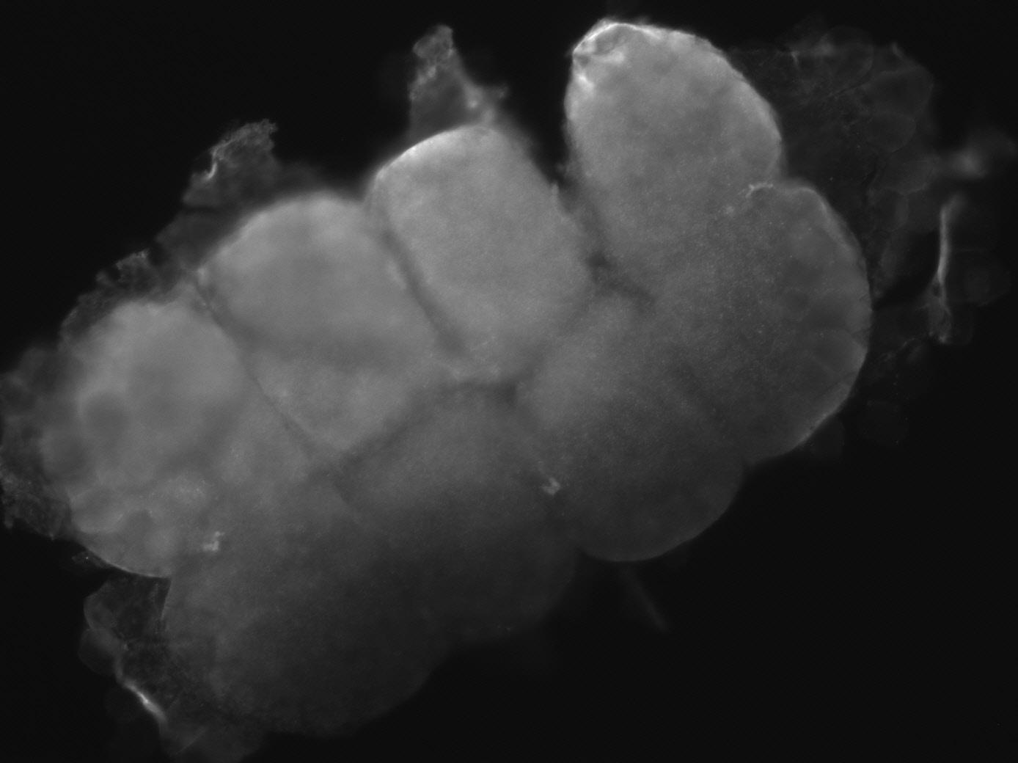
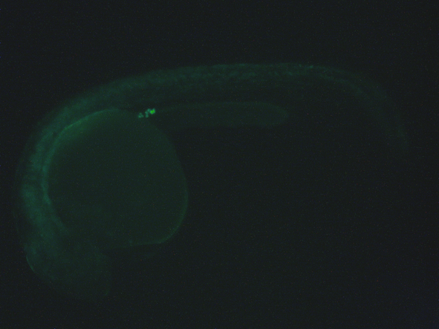
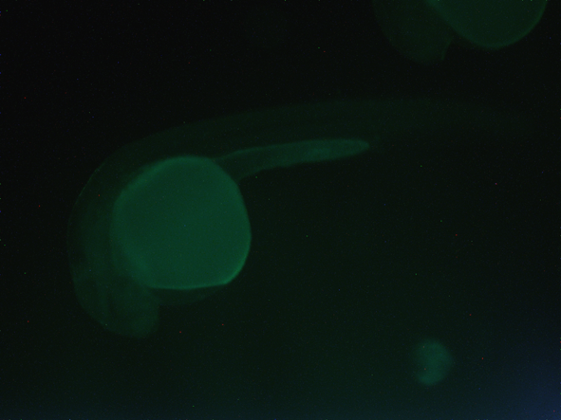
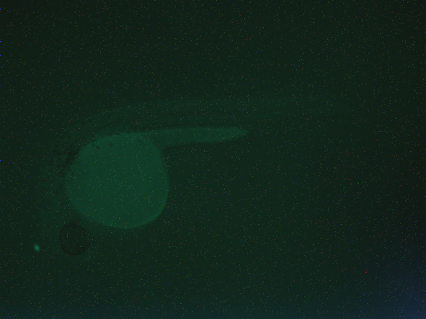
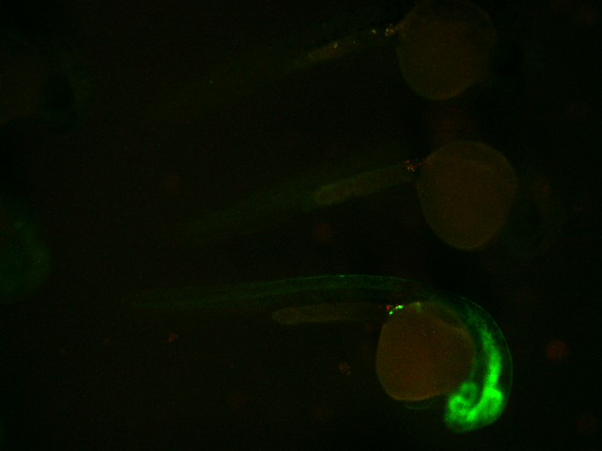
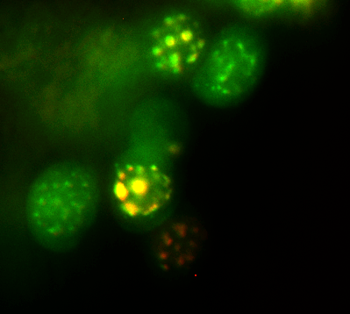
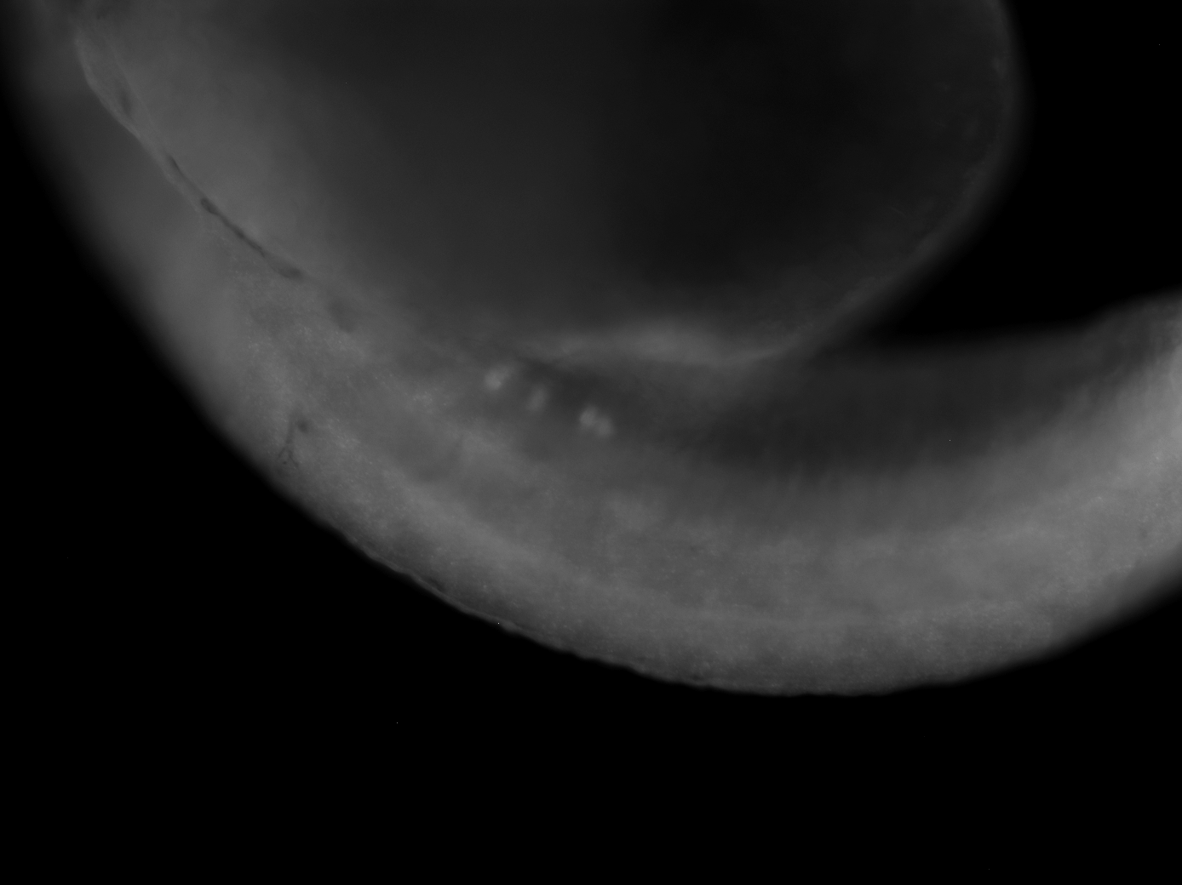
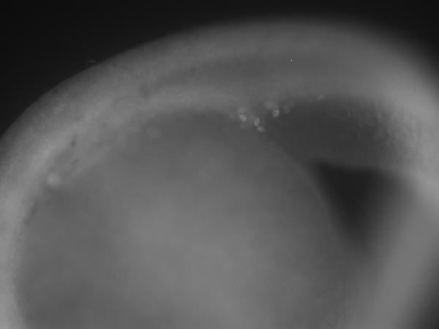
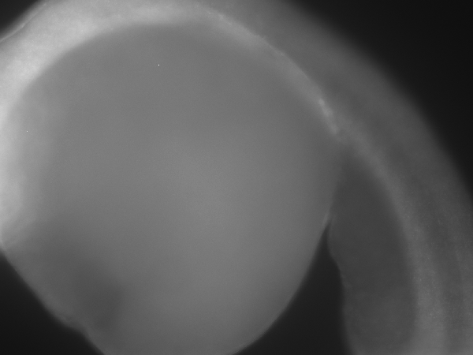
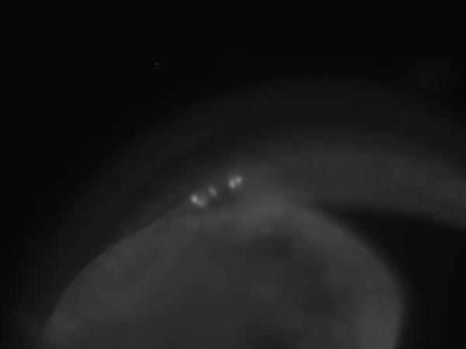
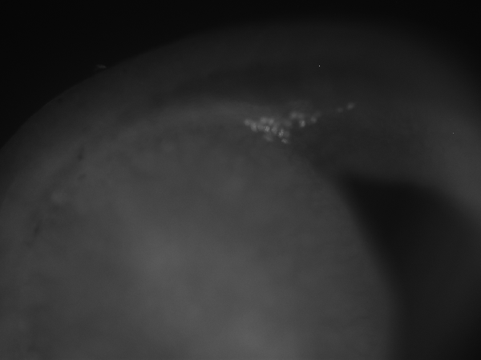
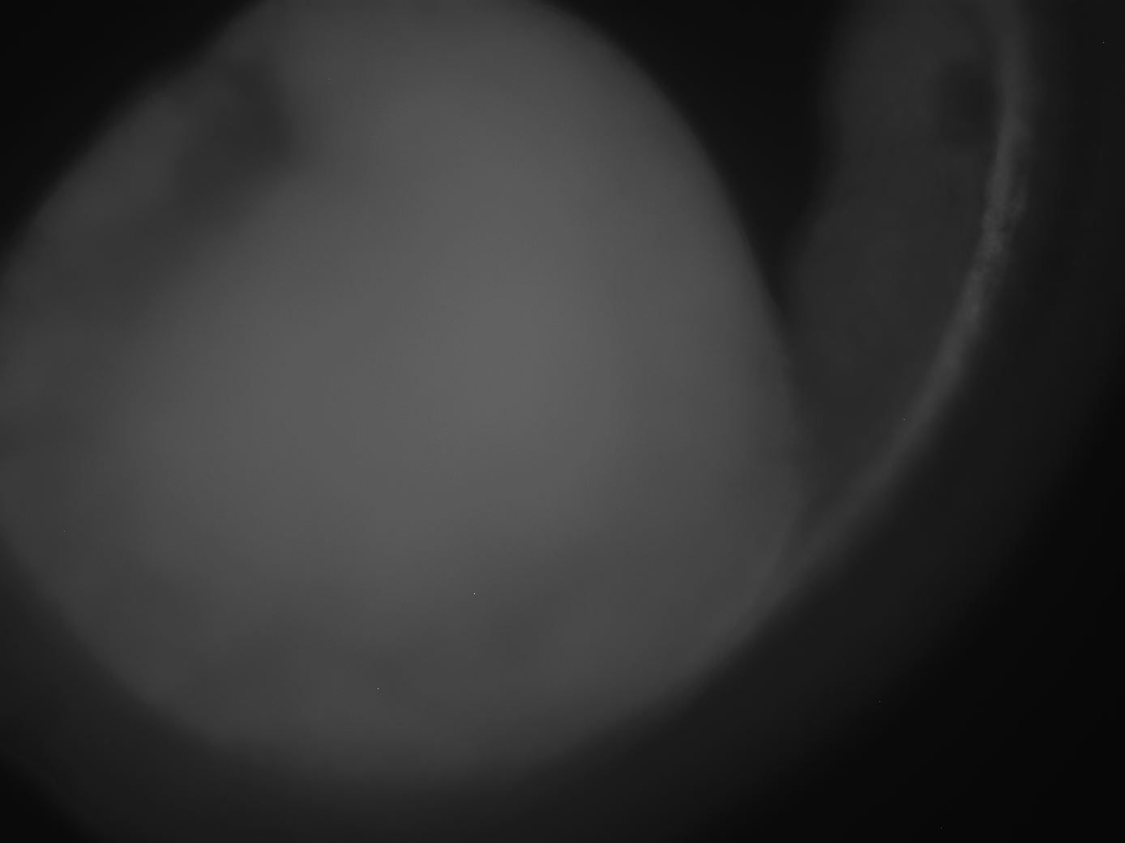
Rbpms2 binds an essential regulator of germ plasm assembly and localizes to the PGCs
Lianna Schwartz-Orbach, Sophie Rothhämel, Andreas Jenny and
Florence L. Marlow
Department of Developmental and Molecular Biology
Albert Einstein College of Medicine, Bronx, NY, USA
Abstract
Rbpms2 binds Bucky Ball
How does Rbpms2 localize in the embryo?
Conclusions
Future Directions
A key event in vertebrate embryonic development is axis specification to form the basic body plan. The first axis, the animal vegetal (AV) axis, is specified during oogenesis. In zebrafish, the first marker of the AV axis is a vegetally localized aggregate of organelles including ER, golgi and mitochondria called the Balbiani Body. Germ plasm is sequestered to the Balbiani body in organisms that specify the germline via inheritance of maternal RNAs. In zebrafish embryos, the germ plasm segregates again to the prospective primordial germ cells (PGCs) during the first mitotic divisions. bucky ball (buc) is the only known gene whose function is required to establish polarity, specify the first axis, and set aside the germline through an unknown mechanism and pathway. We identified RNA binding protein with multiple splicing 2 (Rbpms2) as a Buc binding partner. Rbpms2 is implicated in binding RNAs that encode proteins involved in regulating germ line development. Rbpms2 has an RNA recognition motif and lacks other structurally recognizable domains.
To investigate the spatial and temporal distribution of Rbpms2 protein we generated a GFP-Rbpms2 fusion protein. In transient expression assays, we microinjected mRNA encoding GFP-Rbpms2 and found that the fusion protein becomes restricted to the PGCs. While the 3’UTR plays a prominent role in regulating localization and translation of mRNAs, our gfp-rbpms2 construct lacks the 3’UTR; therefore, it must accumulate in PGCs through a different mechanism. Here we used a structure-function approach to identify regions of Rbpms2 protein necessary and sufficient for PGC localization in zebrafish.
Bucky Ball is the only known regulator of germ plasm assembly. In a Yeast-Two-Hybrid system, Rbpms2 was identified as a Bucky ball binding partner. Rbpms2 was further investigated due to its RNA Recognition Motif and dependence on Buc for its localization in oocytes.
Our data showed that Rbpms2 localizes to the PGCs in early embryonic development. In order to investigate the regions of Rbpms2 necessary and sufficient for its localization we created truncated proteins. The localization of these truncated proteins was examined in transient expression assays in zebrafish embryos.
While full length Rbpms2 is able to localize to the PGCs in early embryos, the truncated proteins that we tested were all unable to localize. The presence of PGC markers indicates that Rbpms2 deletions do not disrupt PGC development, rather the proteins lack an element or conformation necessary for accumulation. Further experiments must be done in order to truly elucidate the mechanism of Rbpms2 localization.
A
B
C
Structure Localization Analysis
Localization to the PGCs?
YES n=120
NO n=176
NO n= 94
NO n=42
In progress
NO n=61
WT
buc
(a) Bucky Ball and (b)Hermes/Rbpms2 localize to the Balbiani Body (arrow) in oocytes. (c) In buc mutants, there is no Balbiani body and Rbpms2 cannot localize.
buc-fl
buc-fl
prey
prey
B
-
C
-
Early stage zebrafish
oocyte
Bait vector
Buc
Hermes/Rbpms2
Rbpms2
control
buc
+ (+) - + (+) -
growth control interaction?
Bucky ball and Rbpms2
co-immunoprecipitate.
Bucky ball and Rbpms2 interact in a Yeast-Two-Hybrid Screen
germ cell mRNAs
RRM
C-term
Rbpms2 is a highly conserved RNA binding protein
Zebrafish
RNP1
RNP2
200aa
mRNA
We hypothesize that Bucky Ball mediates germ plasm assembly through its interaction with Rbpms2 either in oocytes, in embryos, or both.
Human
209aa
87% Id
We microinjected truncated mRNAs encoding GFP fusion proteins and screened for fluorescence at 30 hpf
Mouse
206aa
85% Id
Future directions
Bucky ball is essential for
germ plasm segregation
Xenopus
196aa
87% Id
Point mutations of Rbpms2 to further map the localization region(s).
Knock down experiments of rbpms2.
Buckyball/Rbpms2 co-localization in embryo.
When do Buc and Rbpms2 interact?
Transgenic fish that express Rbpms2 in oocytes (D).
Which Regions of Rbpms2 are
necessary and sufficient for localization?
Injected embryos probed with PGC marker vasa
WT
100 μm
100 μm
Uninjected Full Length Δ35-153 Δ100-201 Δ1-140 Δ1-46
75% epiboly
Shield
75% epiboly
75% epibolv
75% epibolv
75% epiboly
Bright Field
Without buc the germ plasm will not assemble
n=12(15)
Uninjected
n=7(12)
Rbpms2 -FL
Maternally inherited germline
100 μm
200 μm
2
SacI
GFP
n=15(20)
Rbpms2-Δ35-153
Rbpms2-Δ35-153
30 hpf
30 hpf
30 hpf
30 hpf
30 hpf
30 hpf
n=15(20)
References
Bright Field
What is the mechanism?
RNA or Protein?
1. Bontems, F. & Stein, A. Bucky Ball Organizes Germ Plasm Assembly in Zebrafish. Current biology 19, 414-422 (2009).
2. Leu, D. & Draper, B. The ziwi Promoter Drives Germ line-Specific Gene Expression in Zebrafish. Developmental dynamics 239, 2714-2721 (2010).
3. Lindeman, R. & Pelegri, F. Vertebrate Maternal-Effect Genes: Insights Into Fertilization, Early Cleavage Divisions, and Germ Cell Determinant Localization From Studies in the Zebrafish. Mol. Reprod. Dev. 77, 299-313 (2010).
4. Marlow, F. & Mullins, M. Bucky ball functions in Balbiani body assembly and animal-vegetal polarity in the oocyte and follicle cell layer in zebrafish. Dev. Biol. 321, 40-50 (2008).
5. Song, H. & Cauffman, K. Hermes RNA-binding protein targets RNAs-encoding proteins involved in meiotic maturation, early cleavage, and germline development. Differentiation 75, 519-528 (2007).
6. Strasser, M. & Mackenzie, N. Control over the morphology and segregation of Zebrafish germ cell granules during embryonic development. BMC developmental biology 8 (2008).
7. Tsui, S. & Dai, T. Identification of two novel proteins that interact with germ-cell-specific RNA-binding proteins DAZ and DAZL1. Genomics 65, 266-273 (2000).
Bucky ball facilitates germ plasm assembly in oocytes and accumulates at the four cleavage furrows (arrows; animal view) along with germ plasm in embryos. These four cells give rise to PGCs. Buc mutants cannot assemble germ plasm and their progeny, if viable, would be sterile.
Uninjected
FL
SacI
In order to examine the mechanism by which Rbpms2 localizes or accumulates in the PGCs, we are performing in situ hybridizations. We will probe our mRNA injected embryos with GFP to examine the RNA localization.
GFP
We injected WT embryos with the GFP fusion construct RNA and screened at different stages for expression and localization in PGCs (arrows indicate region where PGCs are localized). Top panels show shield and epiboly stage embryos. Lower panels show 30hpf (all embryos are lateral views except the delta 46 construct, which is a dorsal view). Here we see that while full length Rbpms2 can localize to the PGCs, the truncated proteins do not localize.
Outcome | Interpretation
RNA and Protein localize to PGCs | Mechanism involves RNA localization. Cannot exclude additional role of protein stabilization
RNA localizes, Protein does not (in truncations) | RNA localization mechanism intact, either translational element missing or protein stability involved.
RNA does not localize, Protein does | Accumulation in the PGCs, protein only stabilized in PGCs, localized translation
RNA and Protein do not localize | Mechanism likely involves Rbpms2 interaction with PGC specific protein or RNA.
Do truncated Rbpms2 proteins disrupt PGC development?
Two potential mechanisms could explain failure of truncated Rbpms2 proteins to localize to the PGCs. 1) They lack a necessary localization element. 2) The truncated proteins disrupt PGC development.
To distinguish between these possibilities, we examined two PGC markers (Dazl and vasa) in injected embryos. We co-injected Dazl-MT and mRNAs encoding GFP fusion proteins into embryos and examined the localization of the proteins with antibody staining at 30hpf. In a parallel experiment we probed our injected embryos for vasa transcripts. All views are lateral. Arrows indicate PGCs where present or prospective gonad.
Embryos stained for Dazl-MT and GFP fusions
Dazl
30 hpf
Acknowledgements
GFP-Rbpms2 fusion protein localizes to the PGCs (left panel; lateral views) Red fluorescence is the PGC marker Granulito in transgenic fish. In the right panel we see a close up image of the PGC Rbpms2 is localized to the germ granules.
GFP
SURP/Work supported by NIH ROI GM089979
I would like thank Amanda Heim, Odelya Hartung, Xin Li, Raissa Zossou, and Spartak Kalinin.
GFP-nanos 3’UTR GFP-Rbpms2-FL GFP-Rbpms2-Δ35-153
Notes:
*

